Slide 1

Memory Management
CS532: OS Foundations
Lab Assignment
email address: parth2@pdx.edu
partner’s email address:

Slide 2
Instructions: Make a copy of this document, move your copy to your submissions folder and fill the document with your responses. Use the space on each slide to show your responses, and add additional slides as needed.
When ready for grading: complete the lab assignment submission form and include a link to your filled document

Slide 3
Linux utilities: free and pmap
For this assignment you will need to use a Linux system such as linux.cs.pdx.edu so that you can run the tools free and pmap.
When logged into linux.cs.pdx.edu use the man command to learn about these tools. Specifically, run these commands and study the output:
man 1 free
man 1 pmap
You will only need a few of the many features provided by these tools.

Slide 4
1. Use free to answer these questions:
A. How much memory is in your system (in gigabytes)?
B. How much is free?
C. Do these numbers match your intuition?

Slide 5
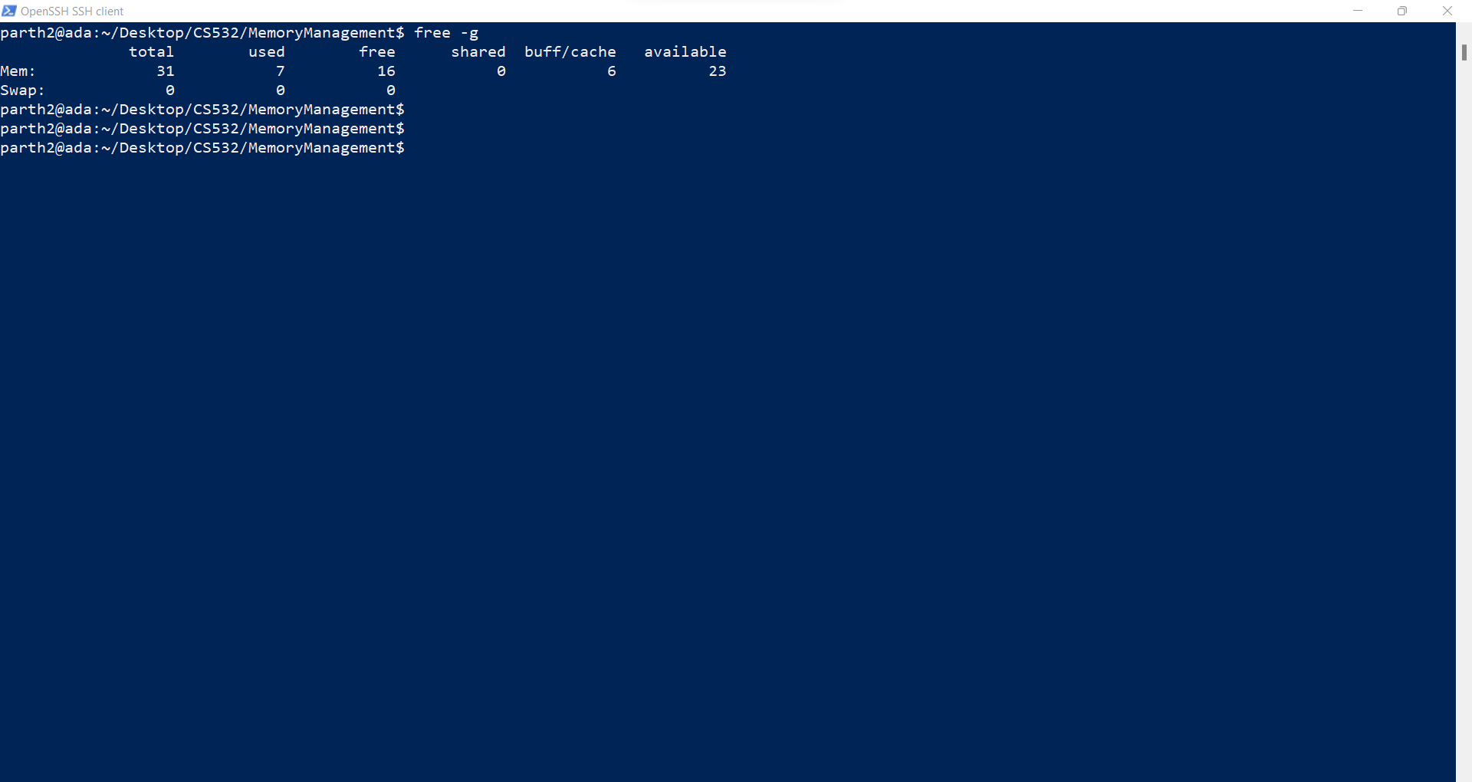
A. How much memory is in your system (in gigabytes)?
Answer: - The total memory in the system is: - 31 GB as given below by the screenshot

Slide 6
B. How much is free?
Answer: - The free memory in the system is 16 GB as given below: -

Slide 7
C. Do these numbers match your intuition?
Answer: - These Numbers match my intuition as has been seen in many computers, the memory utilisation is moderate to high to achieve better efficiency in running the processes.

Slide 8
2. Write, compile and run a C program (call it cs532-memory-user.c) that uses a known amount of memory. This program should take one command line argument: the number of megabytes of memory to allocate. When run, it should allocate an array of this size and repeatedly iterate through the array, touching each entry. The program should do this indefinitely until the user stops it with Ctrl-C.

Slide 9
#include <stdio.h>
#include <stdlib.h>
int main(int argc,char *argv[])
{
//Step-1:- Taking the command line arguments from the user.
if( argc == 2 )
{
printf("The first argument supplied is:- %d\n", argc);
printf("The second argument supplied is %s\n", argv[1]);
}
else if( argc > 2 )
{
printf("Too many arguments supplied.\n");
exit(0);
}
else
{
printf("More arguments expected.\n");
exit(0);
}
C programs should return negative values on error. I suggest you return -1 here.

Slide 10
//Step-2:- Declaration of the variables and constants and taking the number of elements as input
int n, i;
printf ("Enter number of elements:");
scanf ("%d", &n);
printf ("Entered number of elements: %d\n", n);
long long int size = (long long int) atoi(argv[1]);
long long int size_in_bytes = size * 1024 * 1024;
//Step-4:- Taking the Pointer as an memory allocation initialisation and Bytes to MB conversion by multiplying it by 1024*1024
int *x = malloc(size_in_bytes);

Slide 11
//Step-5:- Memory allocation check
if (ptr == NULL) {
printf("Memory not allocated.\n");
exit(0);
}
else {
printf("Memory successfully allocated using malloc.\n");
//Step-6:- Assigning the elements to the array
for (i = 0; i < n; ++i)
{
x[i] = i + 1;
}
printf ("The elements of the array are: ");
while (1)
{
for (i = 0; i < n; ++i)
{
printf ("%d, ", x[i]);
}
}
}
return 0;
}
What is ptr? It is never declared.
i is an int which means that it can only represent 2^31 which is not enough
n is 1024*1024 too small. Need to step through the entire array, not just n elements
Doing a printf() in the inner loop will cause system calls to the OS and I/O operations. These will slow down the program so much that the OS will reclaim much of the program’s physical memory pages. Suggest that you instead just update each value in the array.

Slide 12
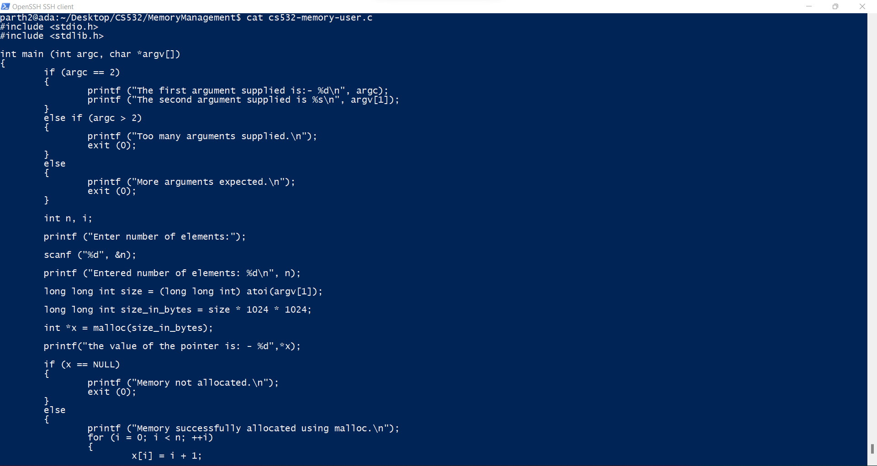

Slide 13
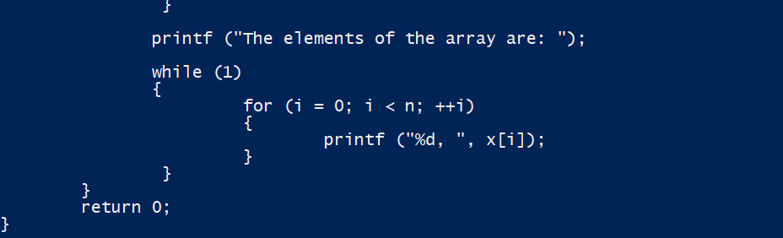

Slide 14
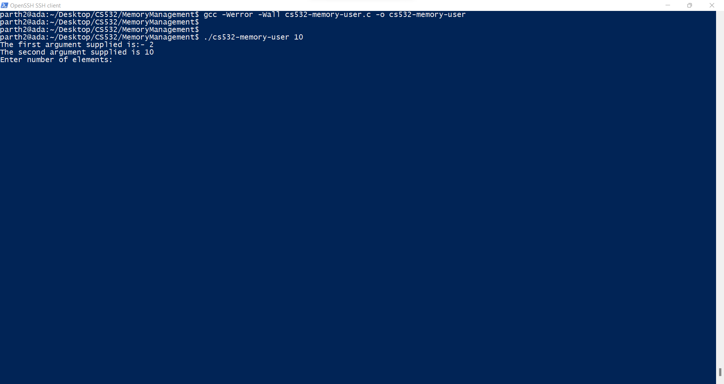
Compiling the program and running it gives us the following screen: -

Slide 15
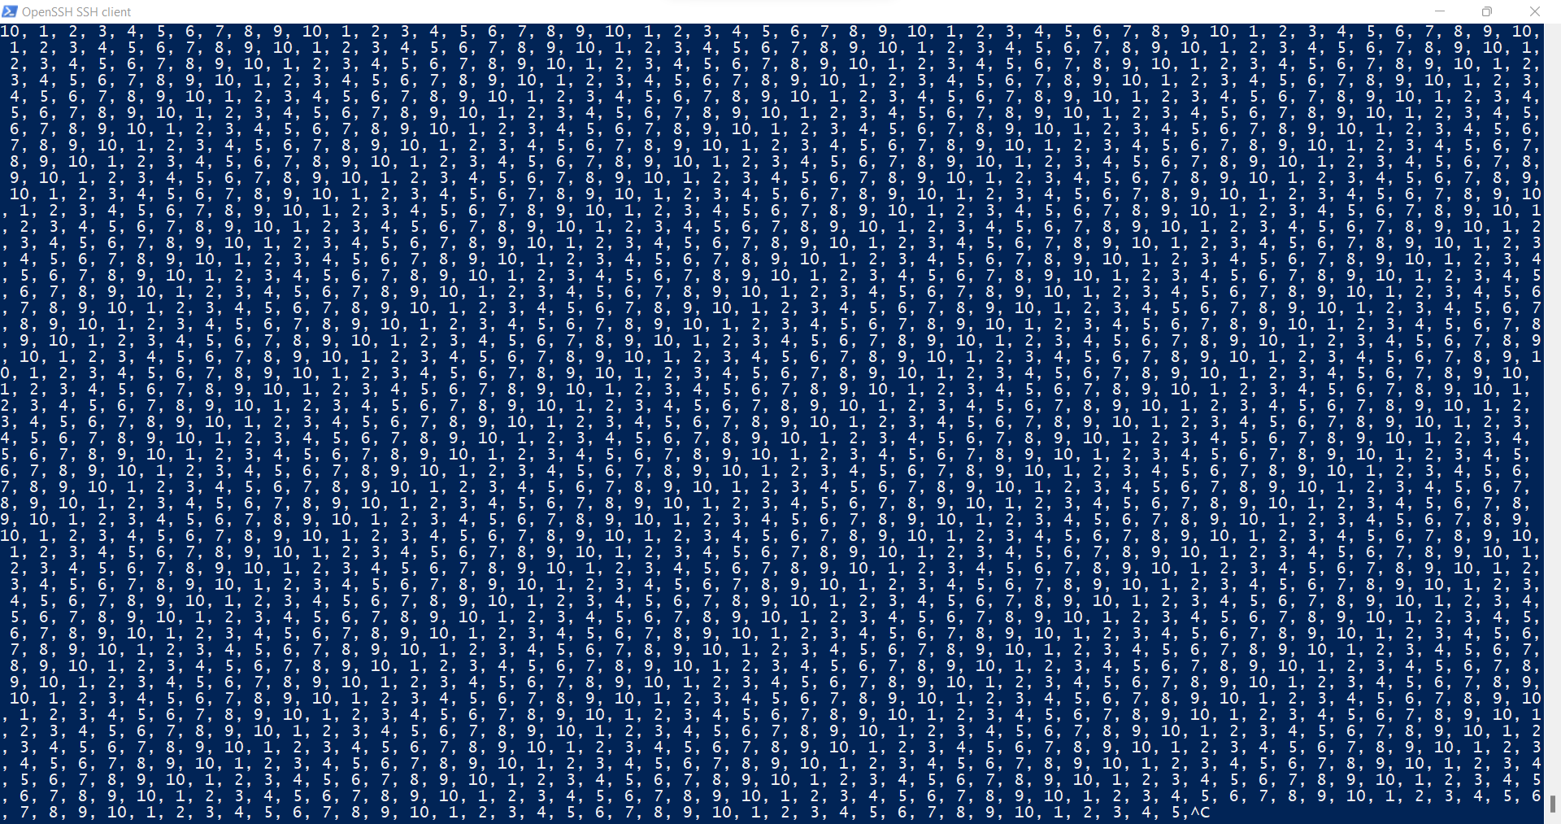
When we enter the number of elements, the loop will assign the elements and iterate it infinitely till ctrl+c is inputted as given below:-

Slide 16
3. Now, while running your cs532-memory-user program, also (in a different terminal window, but on the same machine) run the free tool.
A. How do the memory usage totals change when your program is running?
B. How about when you terminate the cs532-memory-user program? Do the numbers match your expectations?

Slide 17
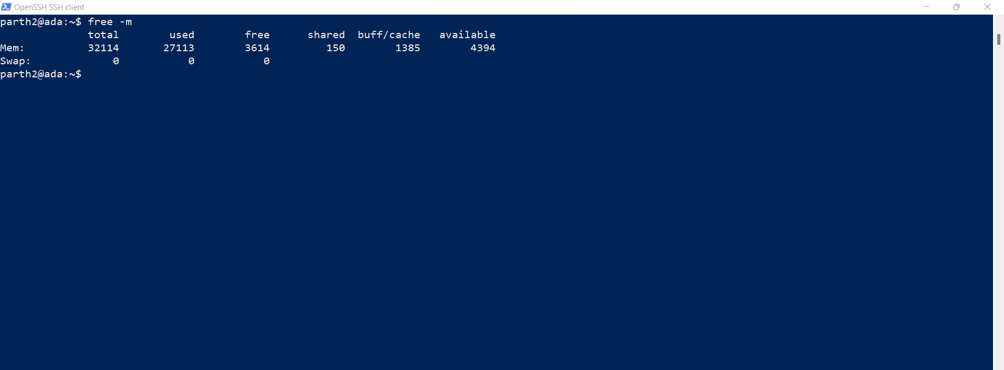
A. How do the memory usage totals change when your program is running?
Answer:- Before the program is executed (in MB):-

Slide 18
After the program is run: -
When the program starts executing, the free memory starts decreasing.

Slide 19
C. Fill the following table using your cs532-memory-user program and the free utility. Record the amount of free memory (in megabytes) before, during and after running cs532-memory-user utilizing each corresponding amount of memory.
 | before | during | after
10 MB | 3499 | 3422 | 3484
100 MB | 3488 | 3404 | 3489
1 GB | 23498 | 23490 | 23564
10 GB | 21573 | 21479 | 21492
100 GB | Segmentation fault | Segmentation fault | Segmentation fault
These experiment results will need to be redone after the code is fixed.

Slide 20
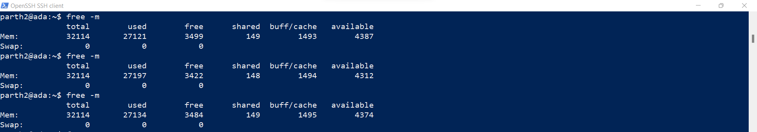
For 10MB as an input, the free -m above shows the before, during and after image respectively.

Slide 21
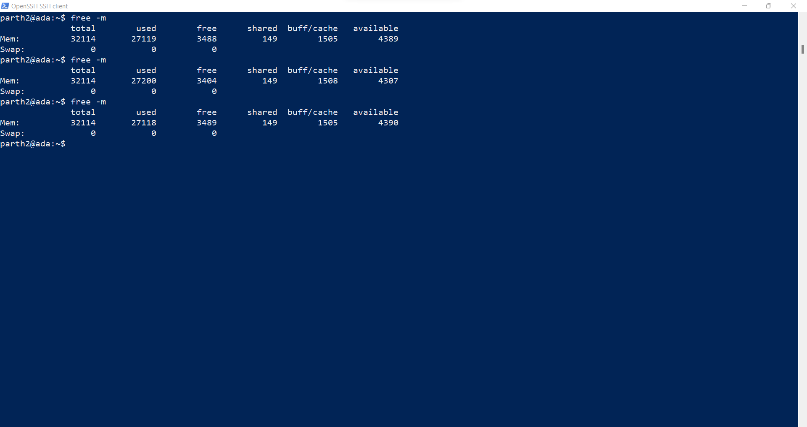
For 100 MB, these are the figures for before, during and after.

Slide 22
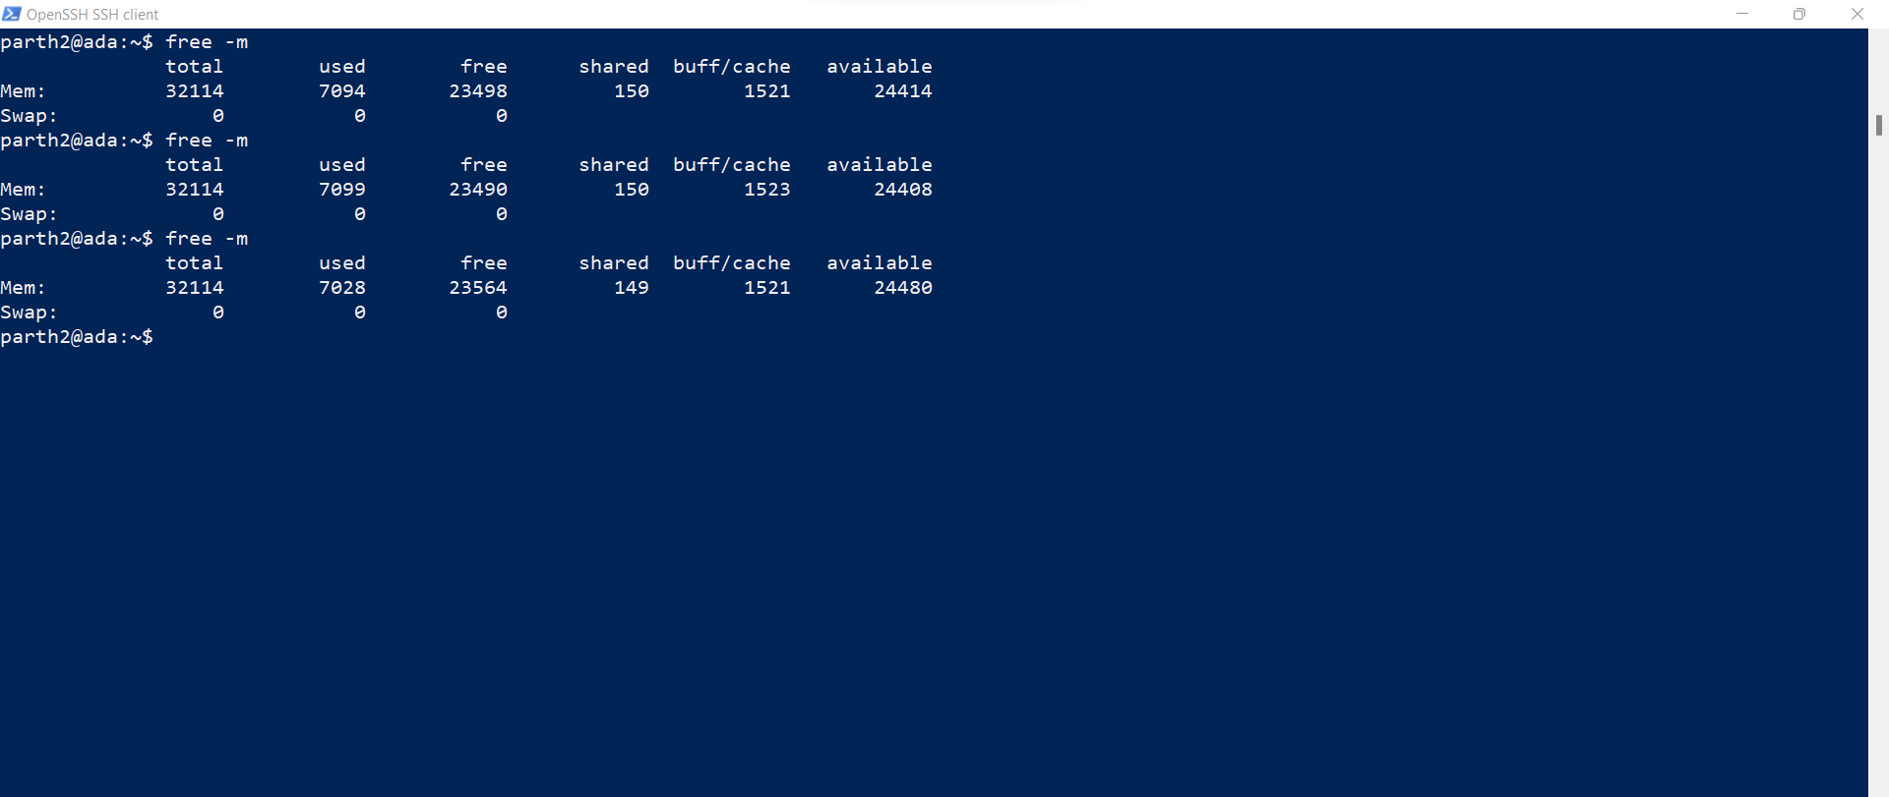
For 1GB, these are the figures for before, during and after

Slide 23
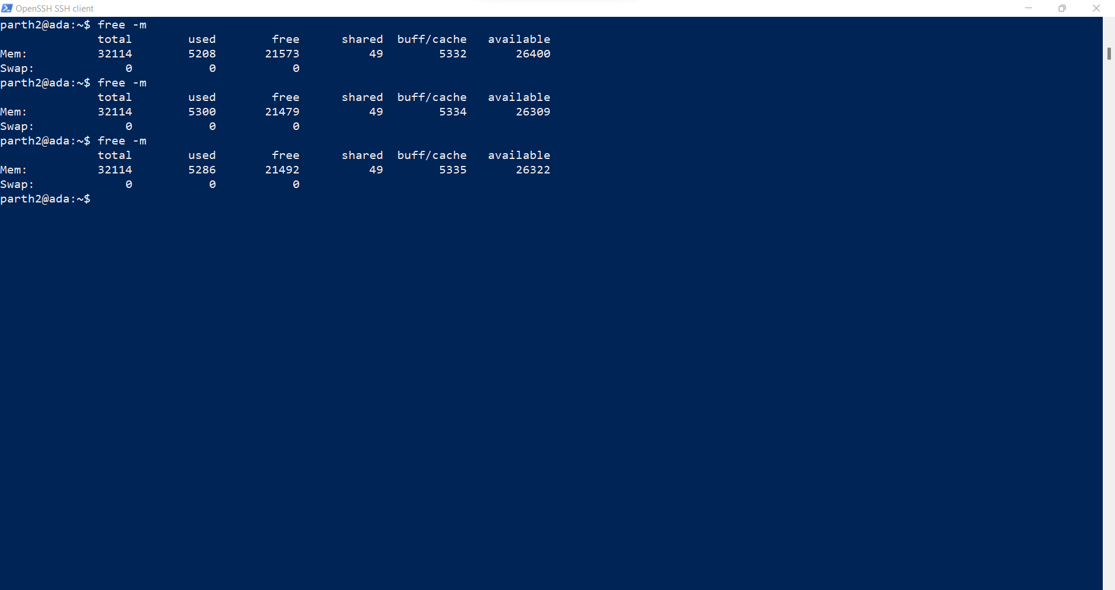
For 10GB, these are the figures for before, during and after

Slide 24
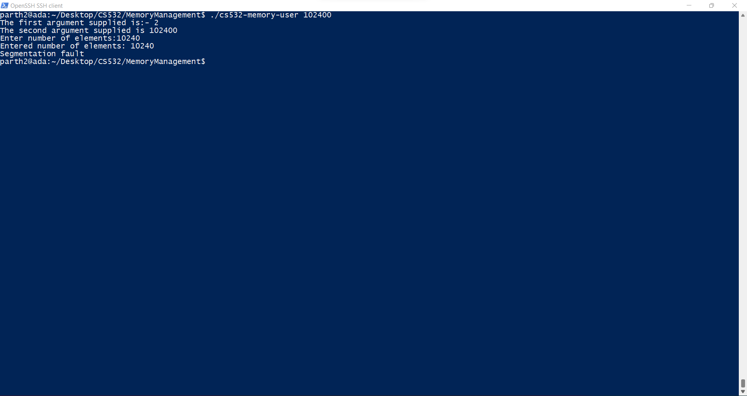
For 100GB, there is a segmentation fault

Slide 25
To use pmap, you must know the ID of the process to monitor. So, first run your cs532-memory-user program in one terminal window (ask it to allocate 100 megabytes). Then, in a separate terminal window, run ps auxw to see a list of all processes. Within that list, find your running cs532-memory-user program and its pid.
Use pmap to print out the memory map of your cs532-memory-user program.

Slide 26
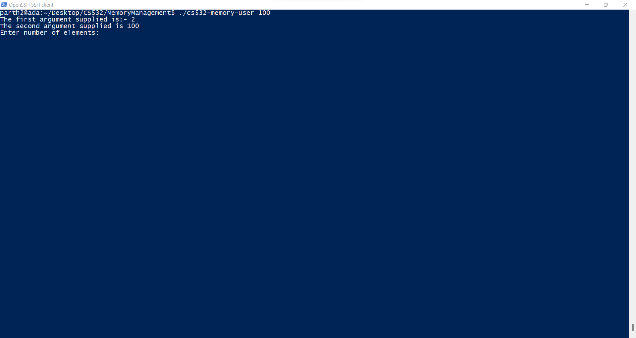
The cs532-memory-user.c program is run with 100 as the argument as given below: -

Slide 27
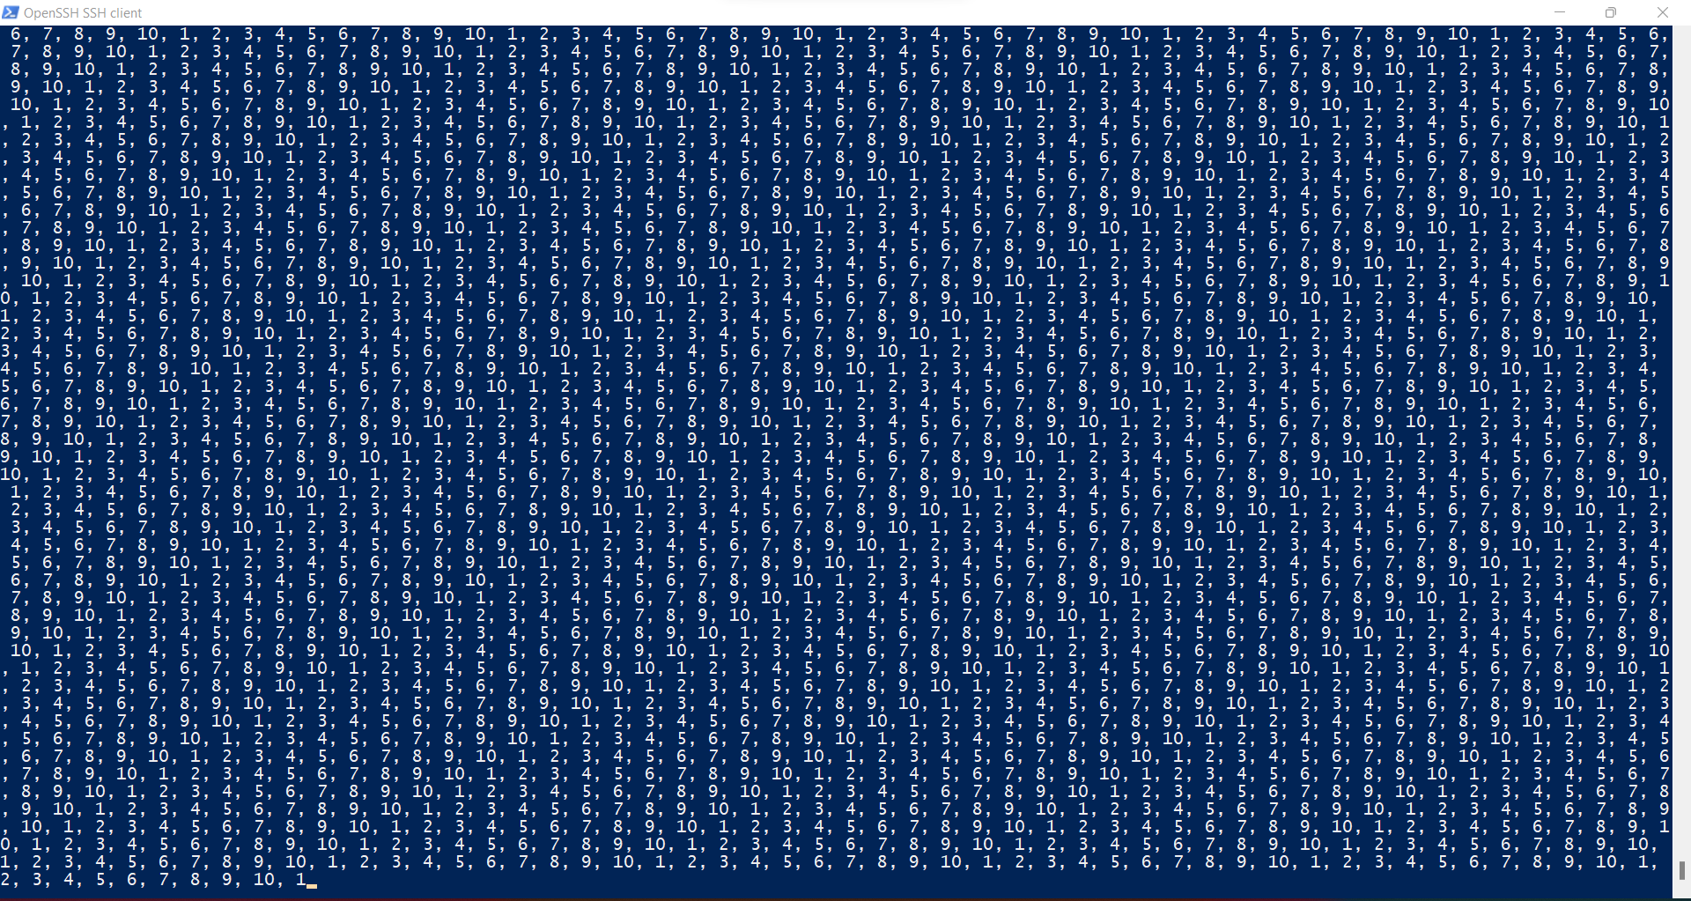

Slide 28
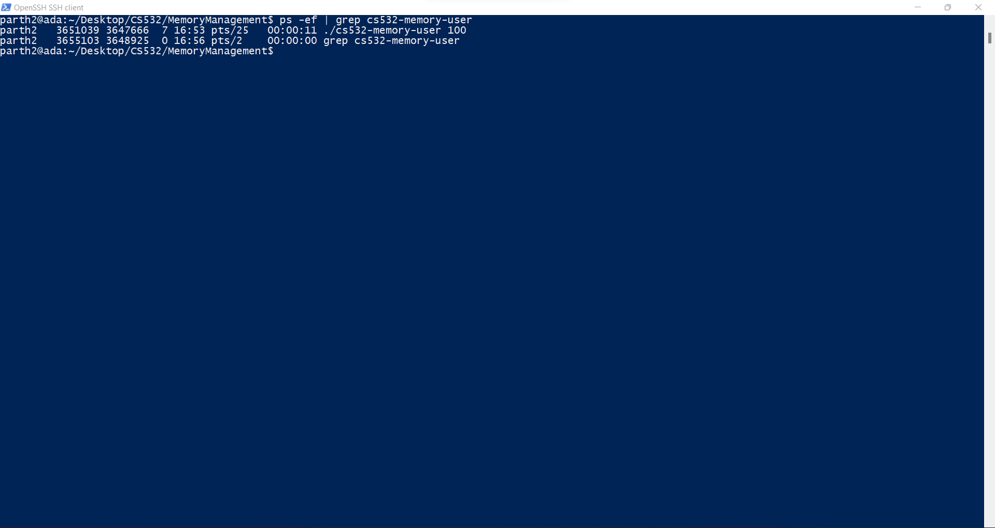
Finding the pid using ps command. It can be achieved in two ways:- using ps -ef | grep <process identifier>

Slide 29
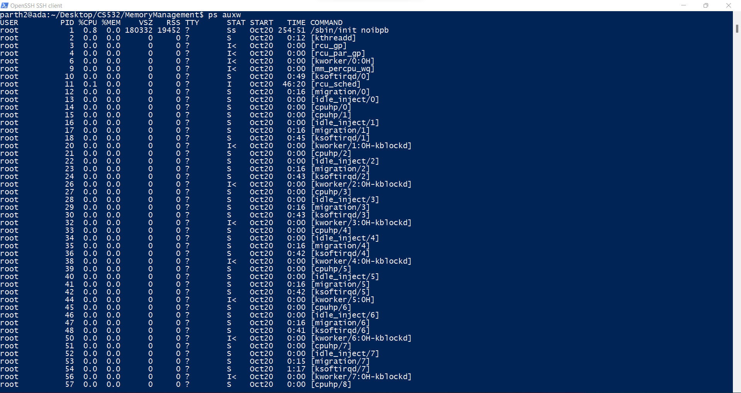
Using ps auxw: -

Slide 30
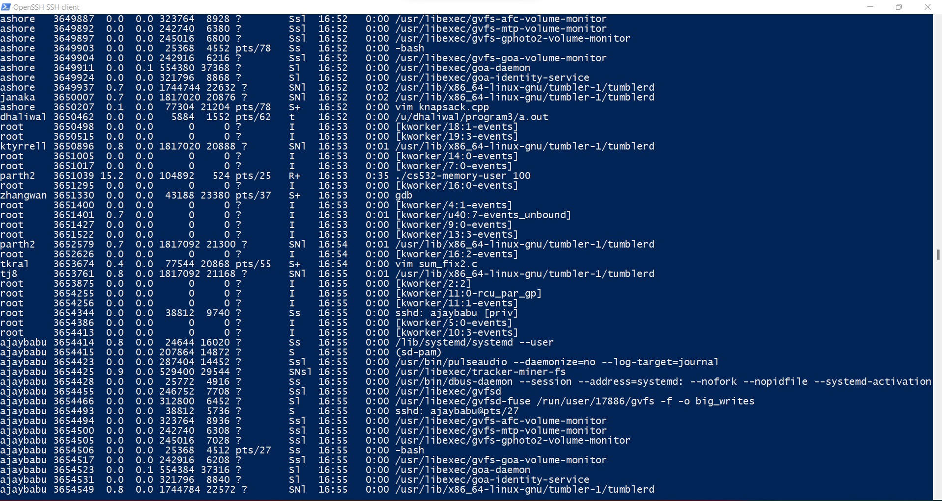

Slide 31
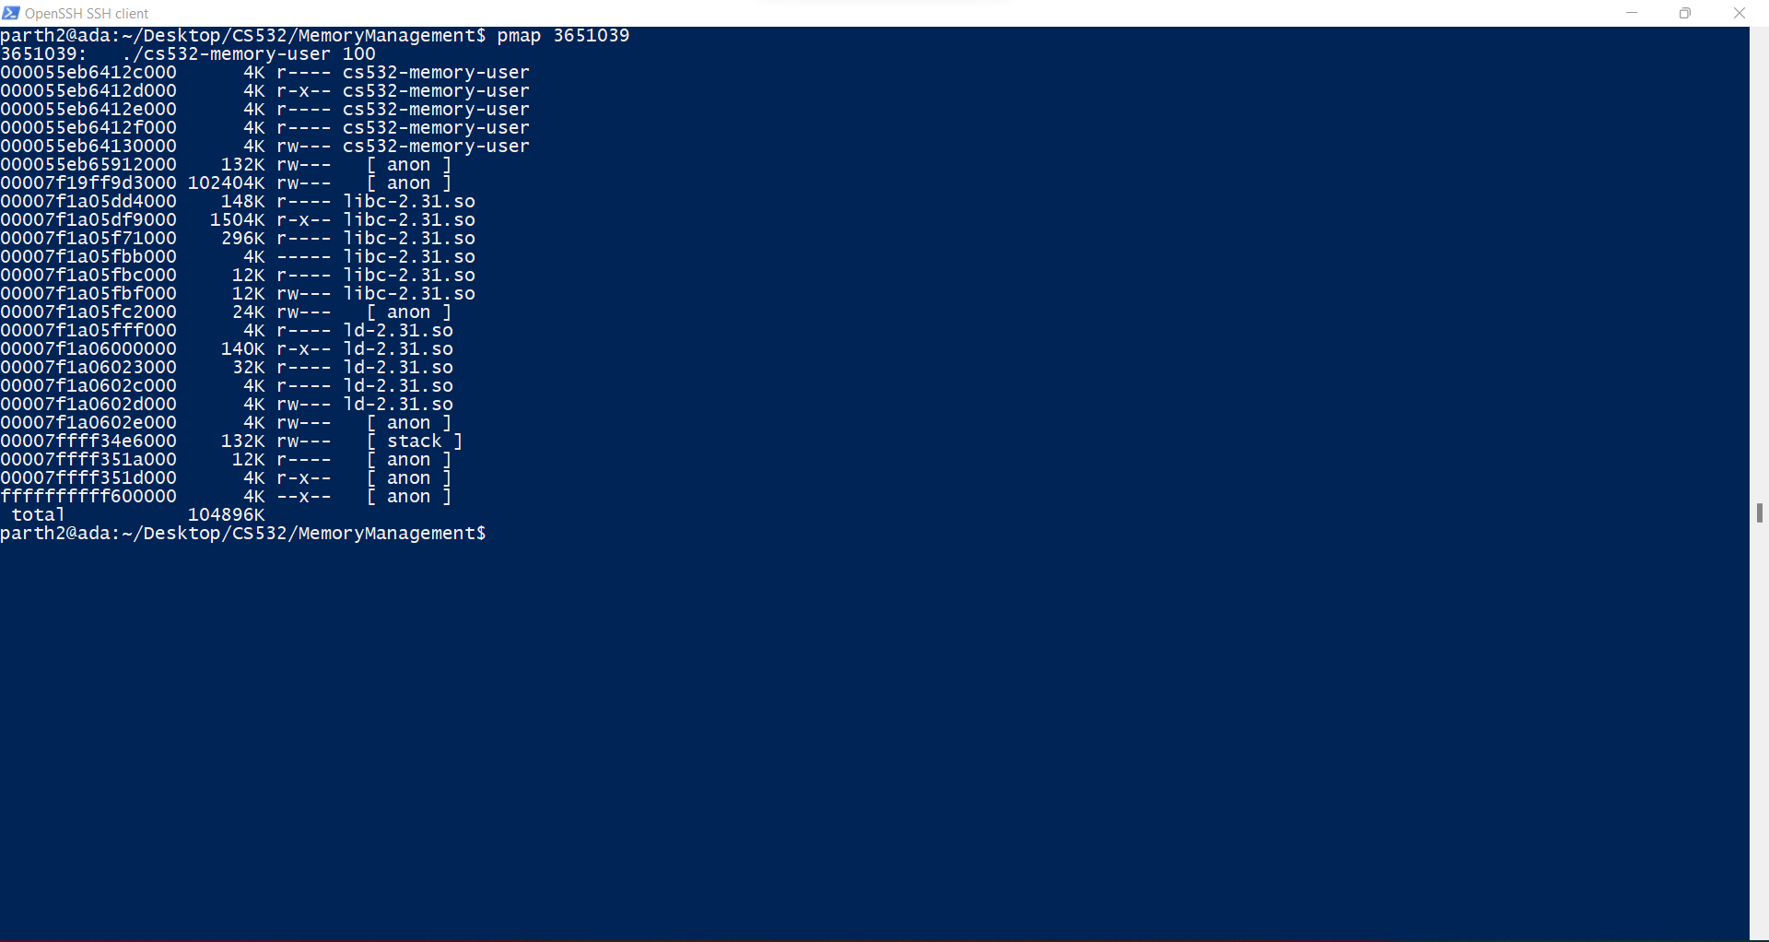
The pmap is given as below:- (using pid as found in the previous steps)

Slide 32
4. Copy and paste a screen capture of the first 10 lines of your pmap output.

Slide 33
5.
A. How many mappings make up the process map for your cs532-memory-user program?
Answer: - 24 mappings
B. What is the smallest size of any mapping shown by pmap?
Answer: - The smallest mapping shown is of size 4K.
The pmap is shown in the screenshot in the subsequent slides.

Slide 34
C. List the 5 largest mappings along with their sizes.
Mapping name | Size (in kilobytes, as reported by pmap)
00007f19ff9d3000 | 102404K
00007f1a05df9000 | 1504K
00007f1a05f71000 | 296K
00007f1a05dd4000 | 148K
00007f1a06000000 | 140K
These are mapping addresses not mapping names.

